Slide 1
The efficacy of CDK inhibitors reported for HR+/HER2– early breast cancer
Fatima aljojo MD medical Oncologist

Slide 2
The active cyclin/CDK complex then phosphorylates proteins, activates them, and sends the cell into the next phase of the cell cycle.
Since the cell with damaged DNA is not stopped, the cell eventually moves out of the G1 checkpoint and prepares for DNA synthesis.
When there is uncontrolled cell growth, it can lead to cancer cells due to the inactivation of the CKIs.
Arellano M, Moreno S. Regulation of CDK/cyclin complexes during the cell cycle.

Slide 3
Version 4.2023, 03/23/23 © 2023 National Comprehensive Cancer Network® (NCCN®), All rights reserved. NCCN Guidelines® and this illustration may not be reproduced in any form without the express written permission of NCCN.

Slide 5
MonarchE
randomised, phase 3 trial, adult patients (aged ≥18 years) who had hormone receptor-positive, HER2-negative, node-positive, early breast cancer at a high risk of recurrence with an Eastern Cooperative Oncology Group performance status of 0 or 1
were recruited from 603 sites including hospitals and academic and community centres in 38 countries.
2023 Jan;24(1):77-90. doi: 10.1016/S1470-2045(22)00694-5. Epub 2022 Dec 6

Slide 6
In patients with HR-positive/HER2-negative, high-risk breast cancer:
Those with ≥4 positive lymph nodes confirmed preoperatively and/or at surgery
Or 1–3 positive lymph nodes with one or more of the following:
grade 3 disease
tumor size ≥5 cm
2 years of adjuvant abemaciclib can be considered in combination with endocrine therapy (category 1)
FDA approves abemaciclib with endocrine therapy for early breast cancer

Slide 7
Between July 17, 2017, and Aug 12, 2019, 5637 patients were randomly assigned (5601 [99·4%] were women and 36 [0·6%] were men).
2808 were assigned to receive abemaciclib plus endocrine therapy and 2829 were assigned to receive endocrine therapy alone.
At a median follow-up of 42 months (IQR 37–47), median invasive disease-free survival was not reached in either group and the invasive disease-free survival benefit previously reported was sustained:
HR 0·664 (95% CI 0·578–0·762, nominal p<0·0001.
. 2023 Jan;24(1):77-90. doi: 10.1016/S1470-2045(22)00694-5. Epub 2022 Dec 6

Slide 8
Five-year efficacy data showed that patients treated with abemaciclib plus endocrine therapy (ET) in the monarchE trial had a reduced risk of disease recurrence compared with patients treated with ET only, with a hazard ratio of 0.680 (95% confidence interval [CI] 0.599–0.772) for invasive disease-free survival (IDFS) and 0.675 (95% CI 0.588–0.774) for distant relapse-free survival (DRFS)
. 2023 Jan;24(1):77-90. doi: 10.1016/S1470-2045(22)00694-5. Epub 2022 Dec 6

Slide 9
Patients with ER+/PR– tumours had a worse prognosis than those with ER+/PR+ tumours.
IDFS rates at 36 months in patients treated with abemaciclib plus ET were 89.9% for those with ER+/PR+ tumours and 83.2% for those with ER+/PR– tumours. For patients treated with ET only, IDFS rates were 85.9% for ER+/PR+ tumours and 72.8% for ER+/PR– tumours.
. 2023 Jan;24(1):77-90. doi: 10.1016/S1470-2045(22)00694-5. Epub 2022 Dec

Slide 11
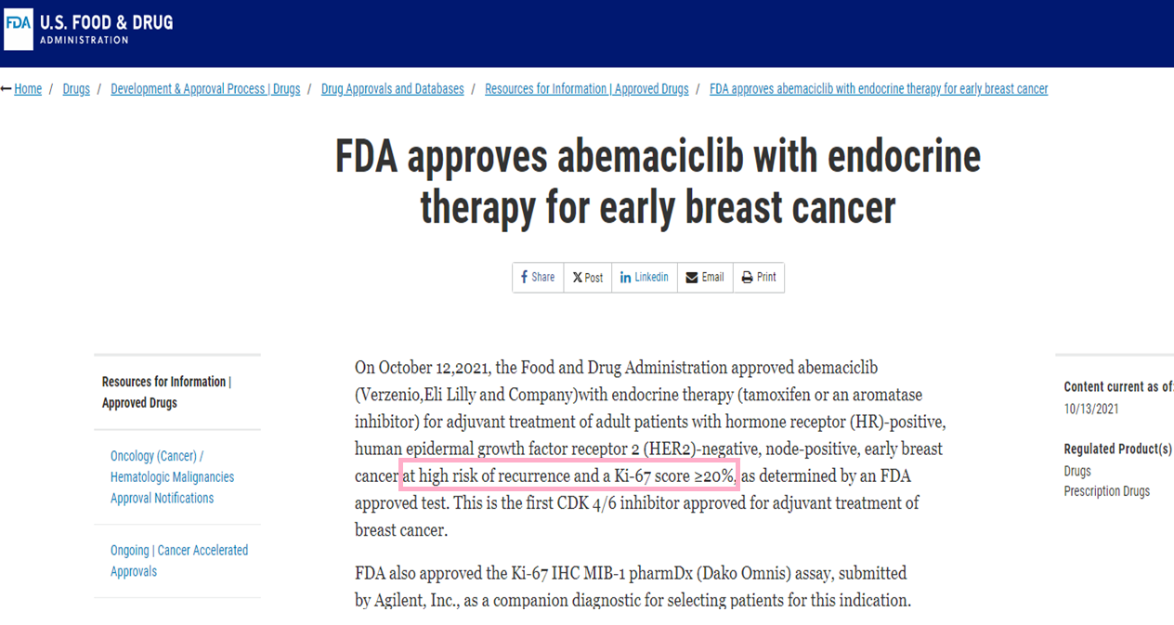
FDA approves abemaciclib with endocrine therapy for early breast cancer

Slide 12
Version 4.2023, 03/23/23 © 2023 National Comprehensive Cancer Network® (NCCN®), All rights reserved. NCCN Guidelines® and this illustration may not be reproduced in any form without the express written permission of NCCN.

Slide 13
The effect of abemaciclib appeared similar when administered at a twice-daily dose of 150 mg versus either 100 mg or 50 mg (hazard ratio 0.905, 95%).
This outcome is not unexpected as we know that dose reduction does not ompromise efficacy in the metastatic setting.
However, it is very important in the curative setting for the agent to be well-tolerated so that patients can continue to receive treatment for an extended period whilst maintaining a good quality of life
. 2023 Jan;24(1):77-90. doi: 10.1016/S1470-2045(22)00694-5. Epub 2022 Dec 6

Slide 14
Almost half of the patients in the monarchE trial required dose reductions of abemaciclib to manage adverse events.
The results of an exploratory analysis presented at the Congress revealed that among the 2,791 patients treated with abemaciclib, 832 (30%) and 389 (14%) required one or two dose reductions .
When the impact of these dose reductions on efficacy was examined in subgroups defined by relative dose intensity, 4-year IDFS rates ranged from 83.7% to 87.1%.
2023 Jan;24(1):77-90. doi: 10.1016/S1470-2045(22)00694-5. Epub 2022 Dec 6

Slide 15
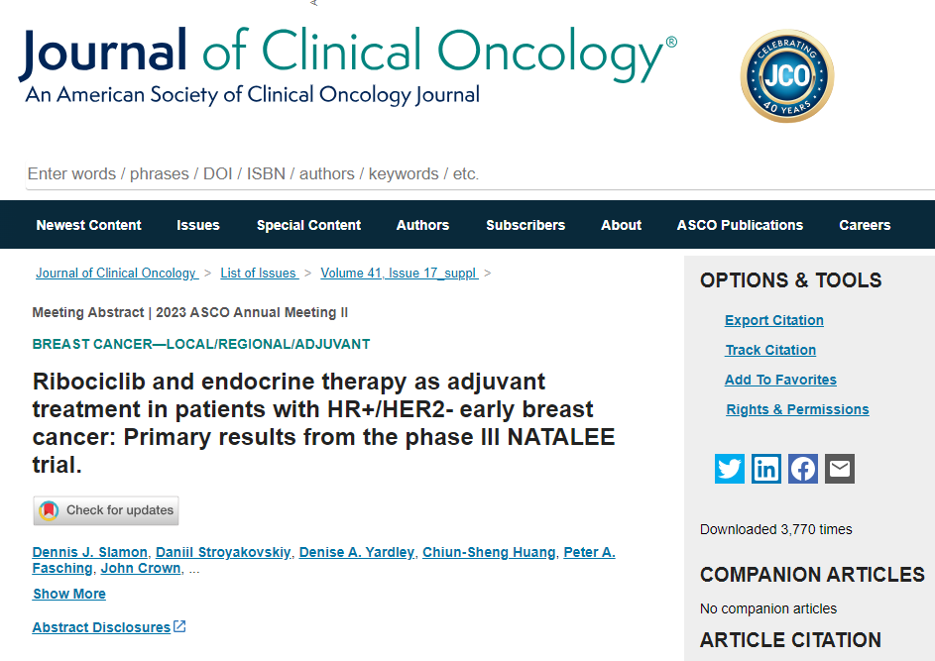

Slide 16
From 10 Jan 2019 to 20 April 2021, 5101 pts were randomized (RIB+ET, n = 2549; ET alone, n = 2552).
As of the data cutoff (11 Jan 2023), median follow-up was 34 mo (min, 21 mo). RIB + ET demonstrated significantly longer iDFS than ET alone
(HR, 0.748; 95% CI, 0.618-0.906; P = .0014); 3-y
iDFS rates were 90.4% vs 87.1%.
iDFS benefit was generally consistent across stratification factors and other subgroups.
. 2023 Jan;24(1):77-90. doi: 10.1016/S1470-2045(22)00694-5. Epub 2022 Dec

Slide 17
600 mg PO qDay for 21 consecutive days followed by 7 days off treatment resulting in a 28-day cycle
Recommended dose modifications for adverse effects
Starting dose: 600 mg/day
First dose reduction: 400 mg/day
Second dose reduction: 200 mg/day
If further dose reduction below 200 mg/day is required, iscontinue the treatment
2023 Jan;24(1):77-90. doi: 10.1016/S1470-2045(22)00694-5. Epub 2022 Dec

Slide 18
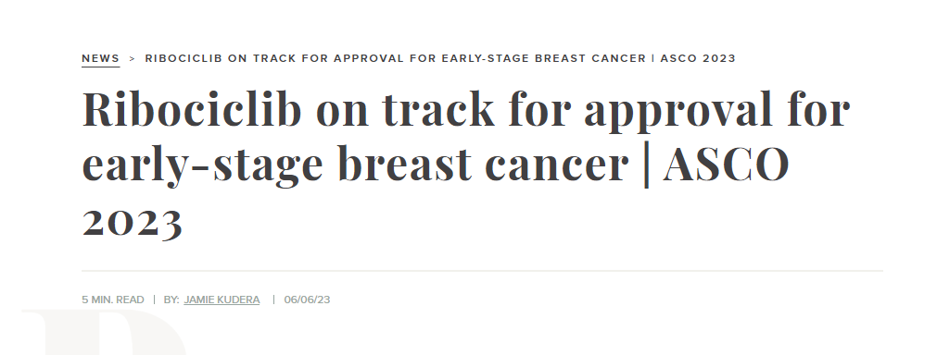
NEWS > RIBOCICLIB ON TRACK FOR APPROVAL FOR EARLY-STAGE BREAST CANCER | ASCO 2023

Slide 19
The fact that additional analyses from both trials confirm previous results is very reassuring since we have already implemented this treatment regimen into clinic practice.
Also, it is very important to have confirmation that a dose reduction for CDK inhibitors is feasible, thus enabling us to offer our patients more tolerable treatment options and improved quality of life
. 2023 Jan;24(1):77-90. doi: 10.1016/S1470-2045(22)00694-5. Epub 2022 Dec

Slide 20
Thanks

